Slide 1

Pruning Pipeline
for YOLOv5s and DETR
Model Compression & Benchmarking on COCO Dataset
Notes:
1

Slide 2
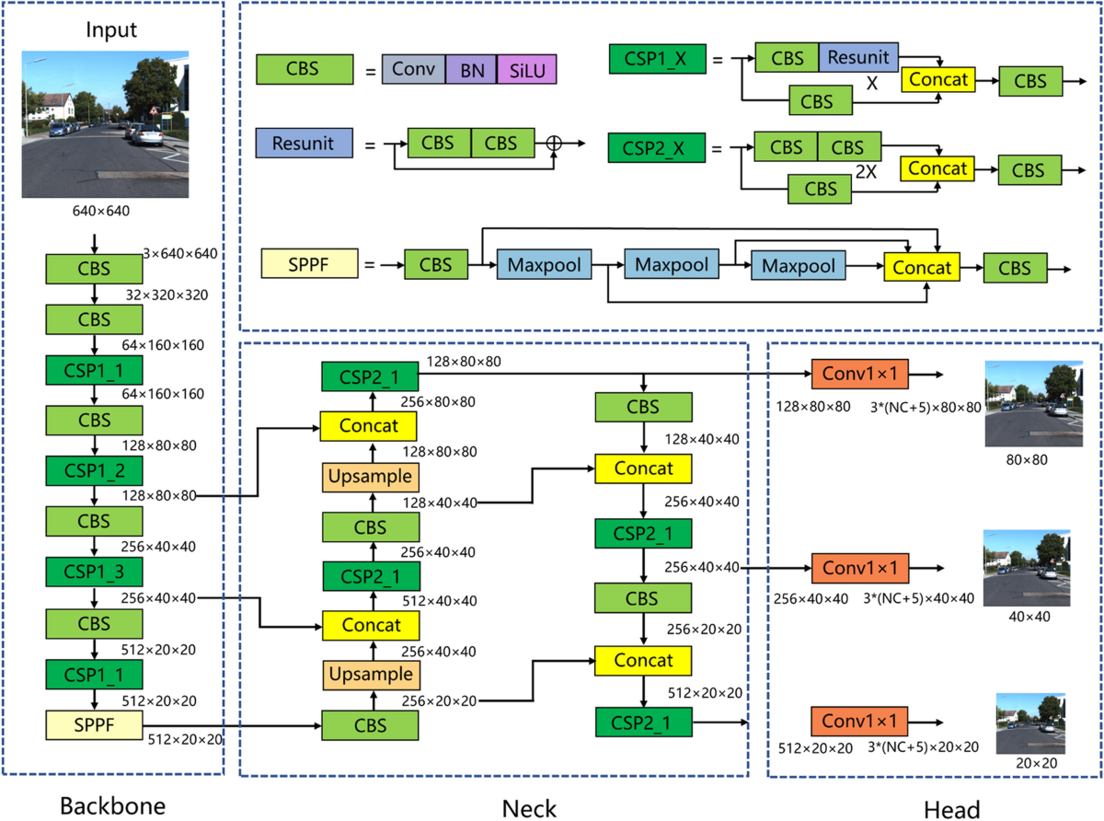
Yolov5s Architecture

Slide 3
Yolov5s Architecture
Architecture
  Backbone: CSPDarknet53 – lightweight and efficient feature extraction.
  Neck: PANet – multi-scale feature aggregation using top-down and bottom-up pathways.
  Head: Anchor-Free detection head for direct object localization and classification.
Model Specifications
  Input size: 640 × 640
  Parameters: ~7.05 million (YOLOv5s)
  Width multiplier: 0.5
  Depth multiplier: 0.33

Slide 4
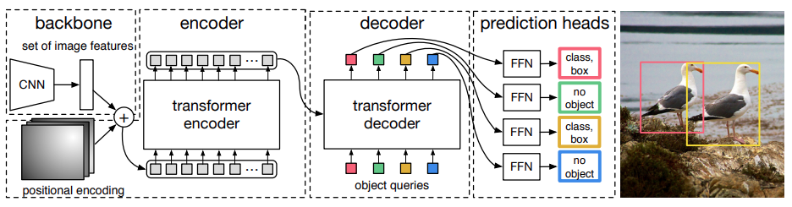
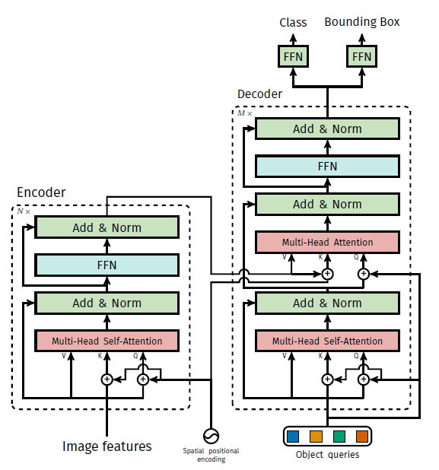
DETR Architecture

Slide 5
DETR Architecture
Core Idea
Formulates object detection as a set prediction problem, eliminating the need for anchor boxes and Non-Maximum Suppression (NMS).
Architecture
  Backbone (ResNet-50): Extracts image features.
  Transformer Encoder : Applies global self-attention to capture long-range contextual information.
  Transformer Decoder : Uses 100 learnable object queries to detect objects.
  Prediction Heads: Predict object classes and bounding boxes.
Training
  Uses Hungarian Matching for one-to-one assignment between predictions and ground truth.
  Loss function combines:
  Classification Loss
  L1 Bounding Box Loss
  Generalized IoU (GIoU) Loss

Slide 6
Preprocessing
Dataset Loading
Resize
  COCO dataset loading & annotation parsing
  Image conversion to RGB format
  Bounding box normalization
  Label mapping to COCO 80 classes
  YOLOv5s: 640 x 640
  DETR: 800 x 800
Normalization
  DETR: ImageNet mean / std
  YOLOv5s: Pixel value scaling
02 / 07
Notes:
2

Slide 7

Postprocessing
DETR Postprocessing
YOLOv5s Postprocessing
Box Decoding
  (cx, cy, w, h) -> (x1, y1, x2, y2)
  Filtering
  Confidence thresholding on class logits
  Key Characteristic
  No NMS required — set-based prediction eliminates duplicates
Anchor Decoding
  Decode anchor boxes at multiple scales
  Score Computation
  Score = objectness x class confidence
  Duplicate Removal
  Apply Non-Maximum Suppression (NMS) to eliminate overlapping detections
04 / 07
Notes:
4

Slide 8
Magnitude Pruning Workflow
Baseline Model
L1 Pruning
Sparse Model
Benchmark
Pruning Details
  Unstructured L1 magnitude pruning — removes weights with smallest absolute values
  Configurable sparsity ratio — target sparsity: 30%, 50%, 70%
  Model protection — critical layers preserved (batch norm, first/last layers)
  Sparse checkpoint saved for evaluation and deployment
05 / 07
Notes:
5

Slide 9
Structure Pruning
Conventional Solution
  Unstructured Pruning removes individual weights, producing a sparse matrix.
  Requires specialized sparse hardware or software optimization to achieve inference speedup.
Proposed Solution
  Structured Channel Pruning (Filter Pruning)
  Completely removes less important convolutional filters.
  Physically reduces the size of the weight tensors.
  Enables direct inference acceleration on standard CPUs and GPUs without requiring specialized hardware.

Slide 10
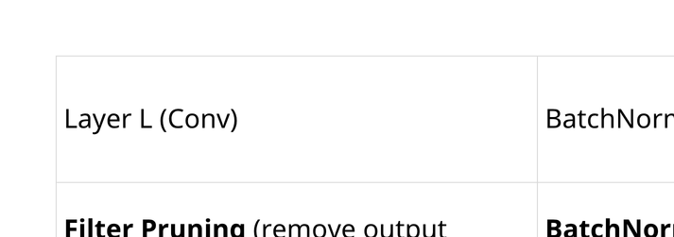
Structure Pruning
Core Principle: Domino Effect in Structured Pruning
When a filter is removed from Layer L, all dependent layers must be updated accordingly.
Key Insight
  Filter Pruning at Layer L and Channel Pruning at Layer L+1 are two aspects of the same physical pruning operation.
  Maintaining tensor consistency becomes particularly challenging in architectures containing skip connections and concatenation operations, such as the PANet used in YOLOv5.

Slide 11
Structure Pruning Workflow
STEP 1 : Sensitivity Analysis
Objective
  Evaluate the impact of pruning each convolutional layer individually.
Methodology
  Analyze 60 convolutional layers in YOLOv5s independently.
  Evaluate three pruning ratios:
    25%
    50%
    75%
  Perform 180 evaluations (60 × 3).
Importance Criterion
  L2-norm of convolution filters
  Filters with smaller L2 norms are considered less important and are pruned first.
05 / 07
Notes:
5

Slide 12
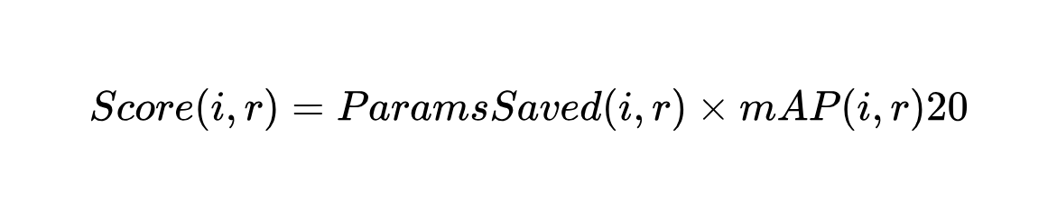
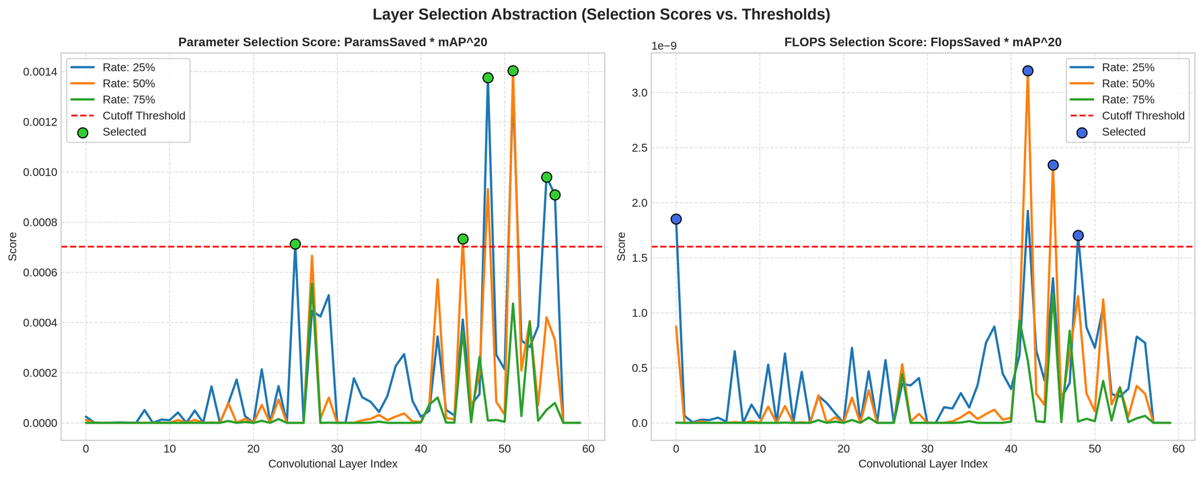
Structure Pruning Workflow
STEP 2: Layer Selection
Layer Ranking Strategy
Each candidate layer is assigned a score:
Selected Layers

Slide 13
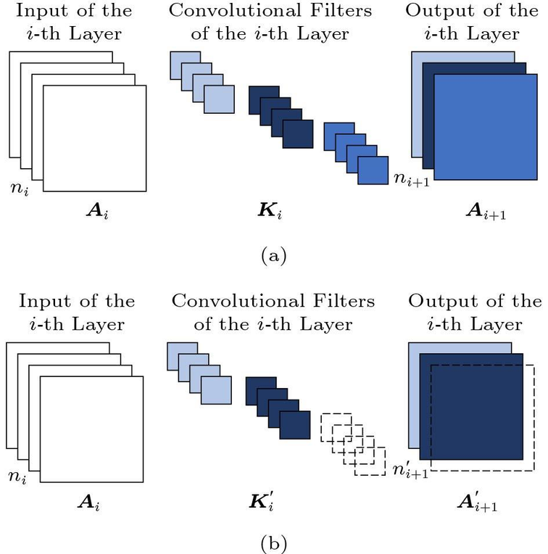
Structure Pruning Workflow
Pruning Mechanism
For each selected layer, three synchronized operations are performed:
Filter Pruning (Layer L)
  Remove low-importance filters based on L2-norm.
  Reduce the number of output channels.
BatchNorm Synchronization
  Update BatchNorm parameters (γ, β, μ, σ²)
  Ensure consistency with the remaining filters.
Channel Pruning (Layer L+1)
  Remove the corresponding input channels.
  Maintain tensor compatibility across consecutive layers.

Slide 14
